Slide 1


Macroscopic simulation of near-threshold high harmonic generation using microscopic TDSE calculations
Ran Reiff, Joel Venzke, Carlos Hernández García
Agnieszka Jaron-Becker, and Andreas Becker

Slide 2
Goals
Simulate the strong-field process of High Harmonic Generation
Identify features which may be visible in experiment
Stable to small variation of intensity
Phase-matched for macroscopic radiators (e.g., gas jets)
Investigate characteristics of the low-order spectra, near the target’s ionization and excitation energies

Slide 3








Macroscopic radiation
$$x$$
Incident laser
$${\vec{r}}_{d}$$
Detector
$$θ$$
$$O$$
$$z$$
$$Z_{0}$$
$$y$$
Target
$$\vec{E}\left({\vec{r}}_{d},ω\right)=\sum_{j}{\frac{1}{c^{2}\left|{\vec{r}}_{d}\right|}q\vec{a}\left({\vec{r}}_{j},ω\right)\exp\left[−i\frac{ω}{c}\left|{\vec{r}}_{d}−{\vec{r}}_{j}\right|\right]}$$

Slide 4
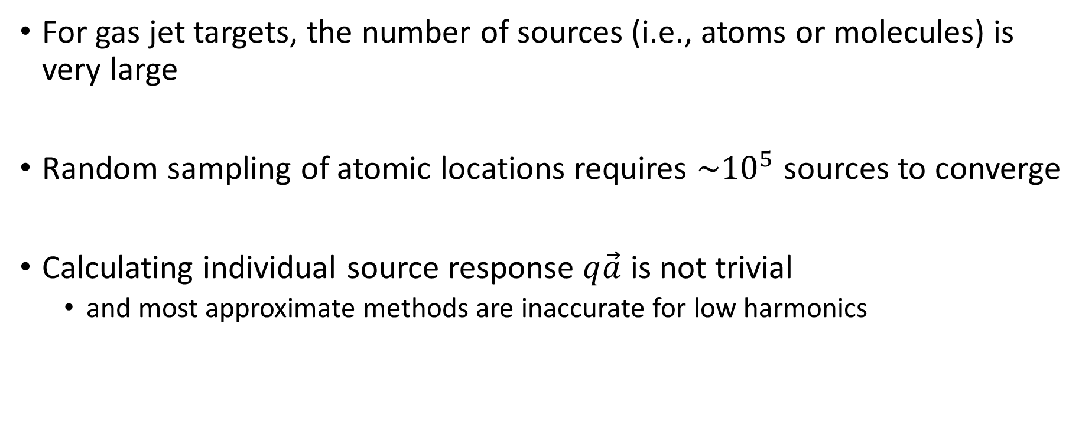
The Problem
For gas jet targets, the number of sources (i.e., atoms or molecules) is very large
Random sampling of atomic locations requires $\sim {10}^{5}$ sources to converge
Calculating individual source response $q\vec{a}$ is not trivial
and most approximate methods are inaccurate for low harmonics

Slide 5
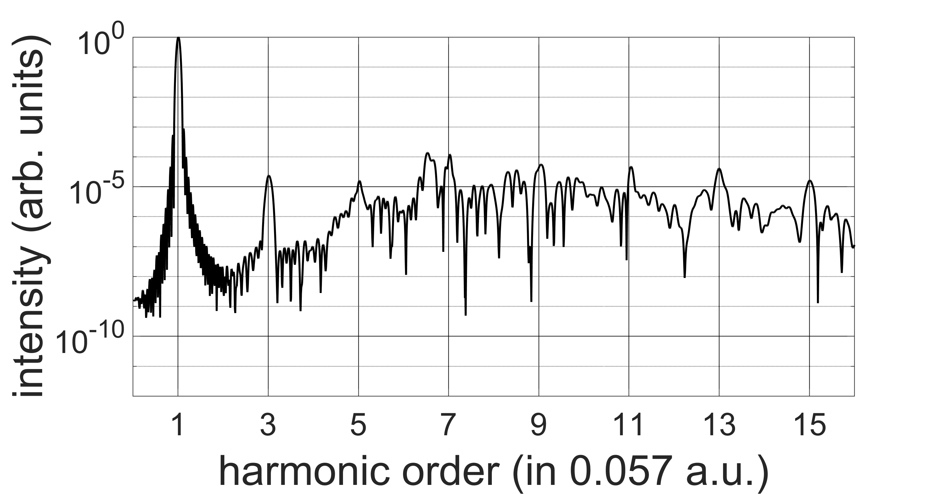
Microscopic radiation
Hydrogen, 800 nm, 20 o.c. sin² envelope, $7×{10}^{13} W/cm^{2}$

Slide 6
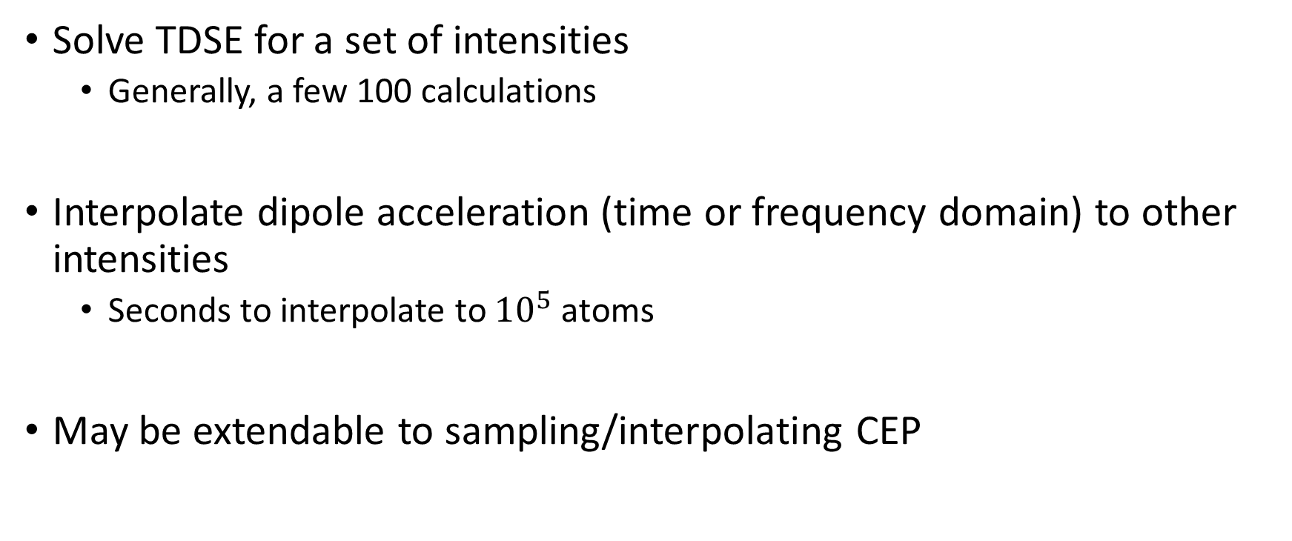
Interpolation
Solve TDSE for a set of intensities
Generally, a few 100 calculations
Interpolate dipole acceleration (time or frequency domain) to other intensities
Seconds to interpolate to ${10}^{5}$ atoms
May be extendable to sampling/interpolating CEP

Slide 7
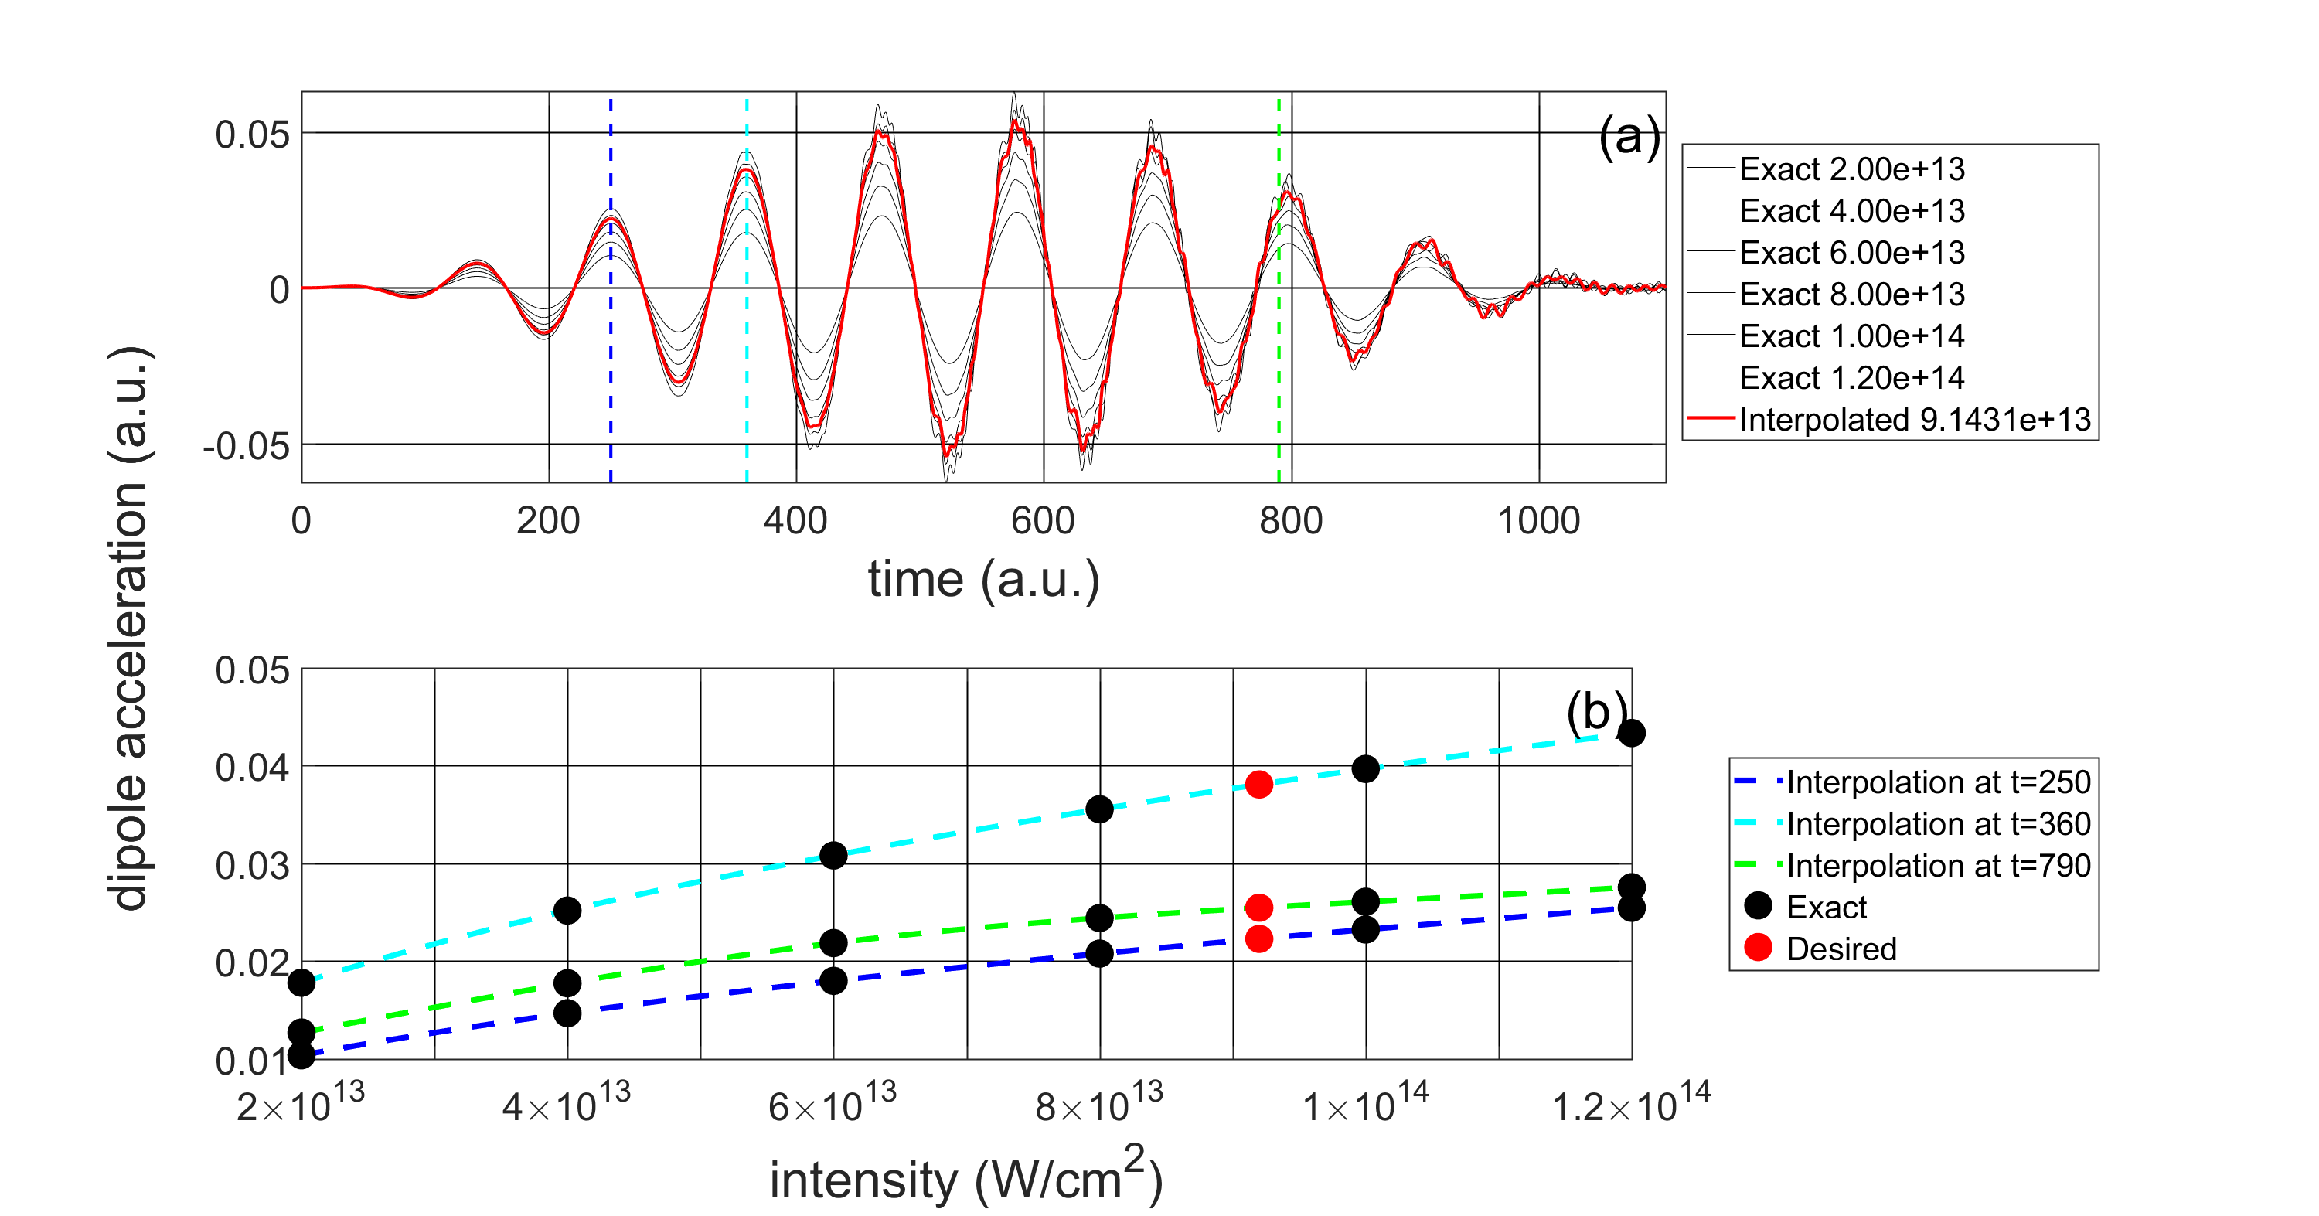
Interpolation

Slide 8
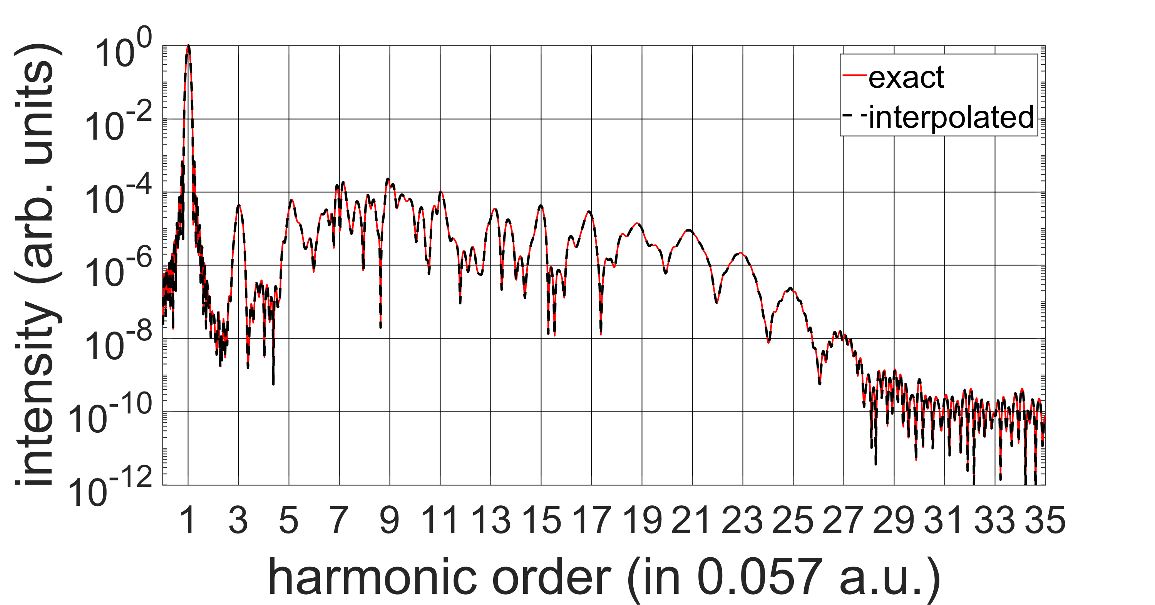
Interpolation
Hydrogen, 800 nm, 20 o.c. sin² envelope, interpolation from ${10}^{12} W/cm^{2}$ steps
to random intensity $\sim 9.1431×{10}^{13} W/cm^{2}$

Slide 9
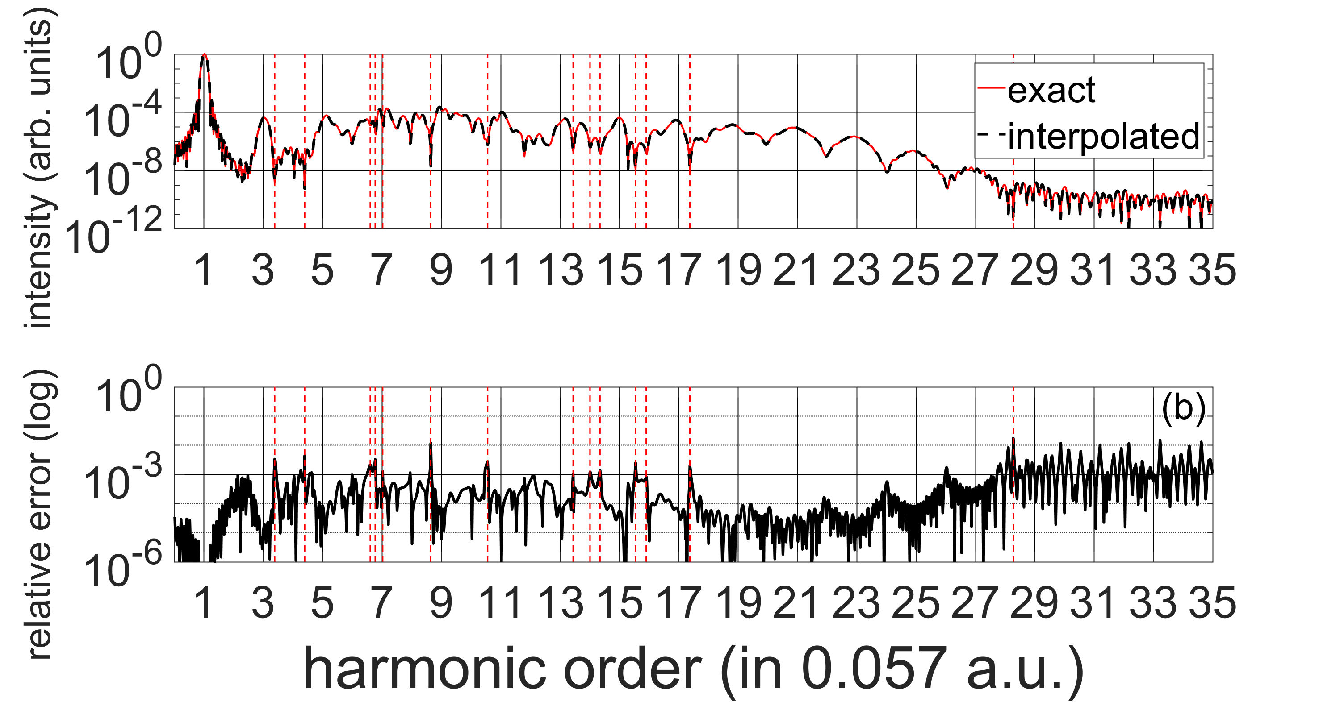
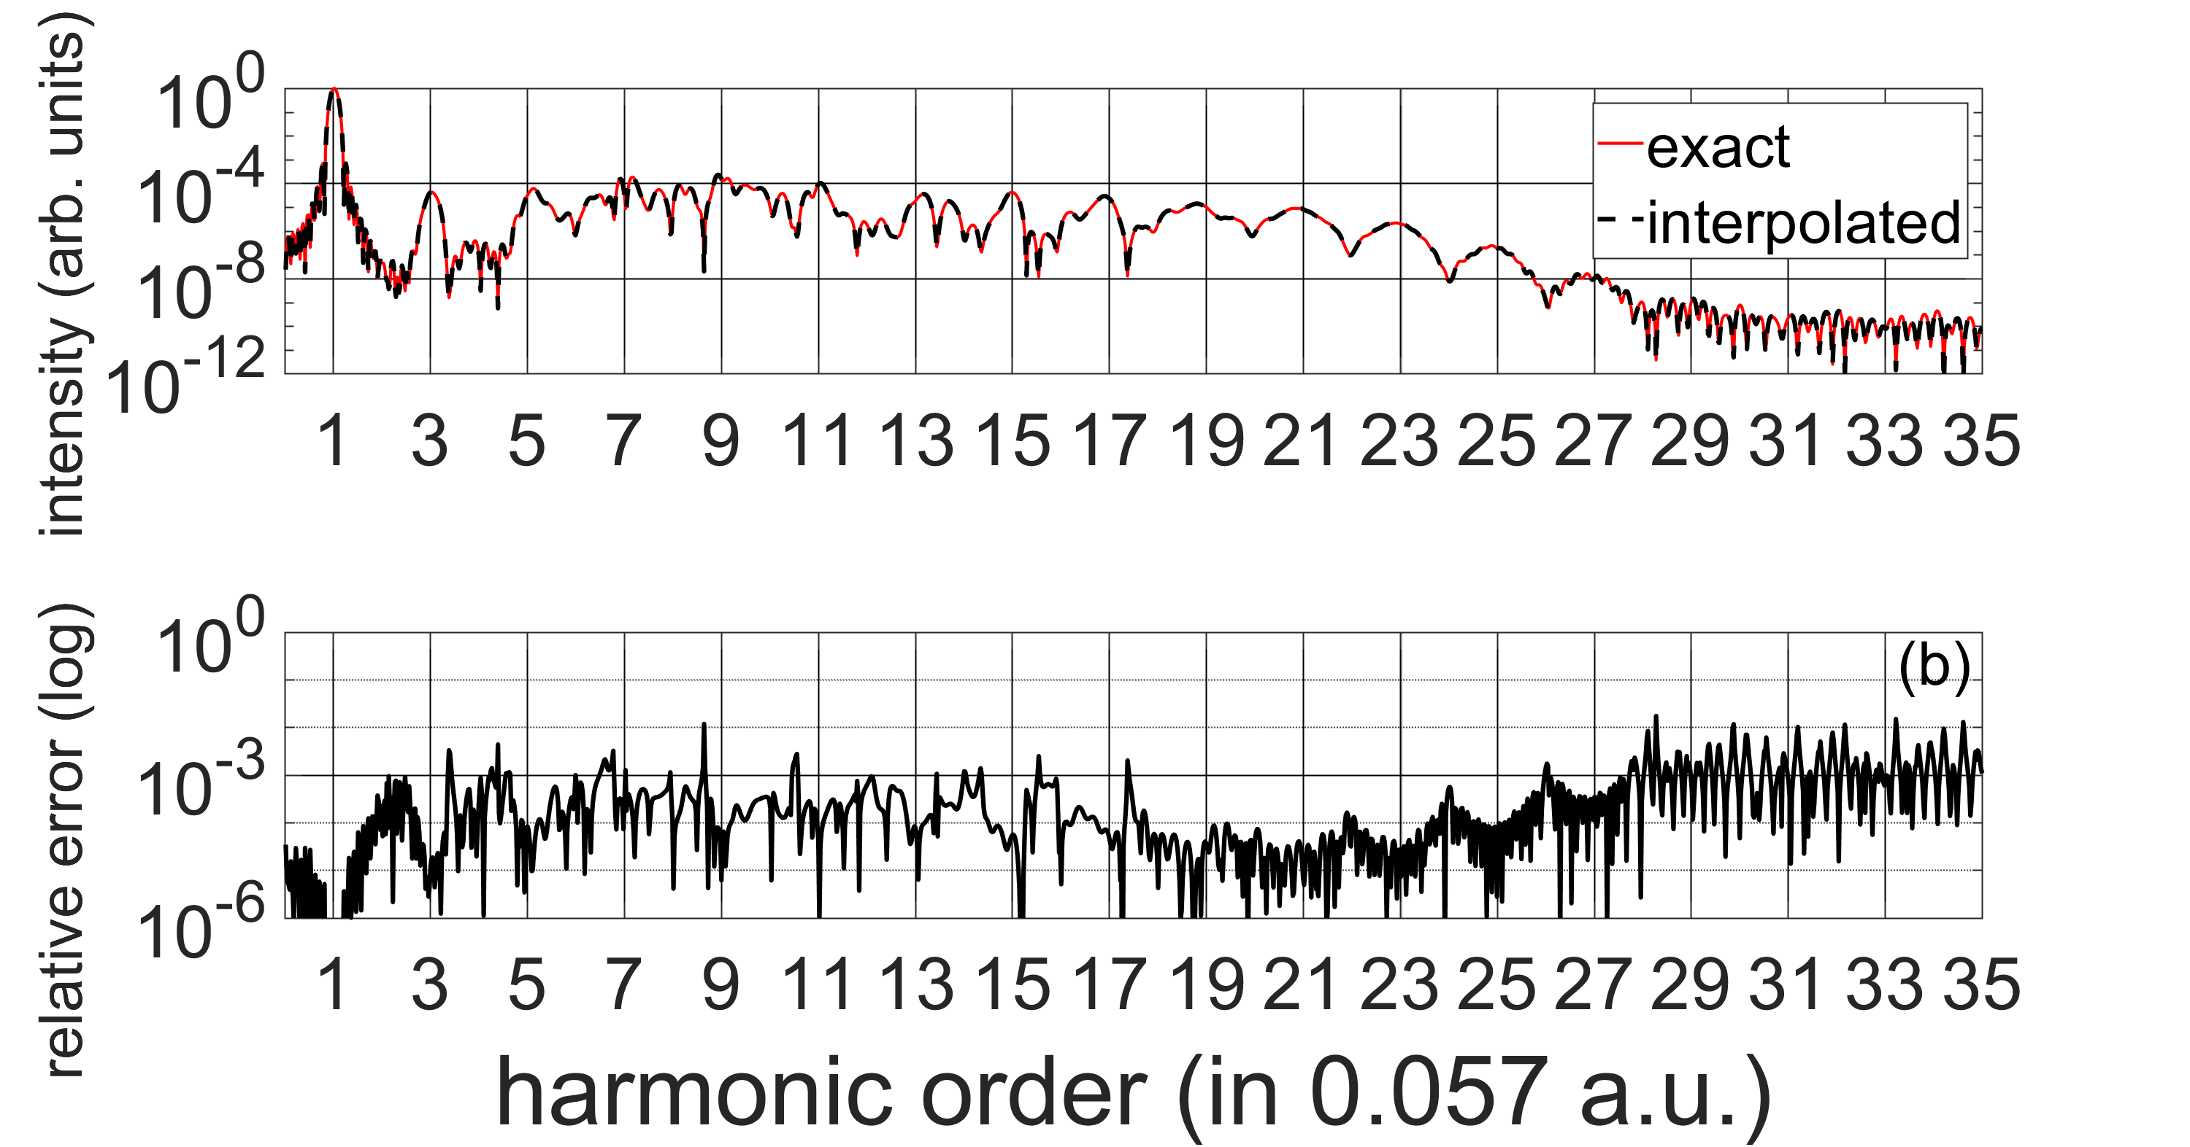
Interpolation
Hydrogen, 800 nm, 20 o.c. sin² envelope, interpolation from ${10}^{12} W/cm^{2}$ steps
to random intensity $\sim 9.1431×{10}^{13} W/cm^{2}$

Slide 10
Interpolation
Hydrogen, 800 nm, 20 o.c. sin² envelope, interpolation from ${10}^{12} W/cm^{2}$ steps
to random intensity $\sim 9.1431×{10}^{13} W/cm^{2}$

Slide 11
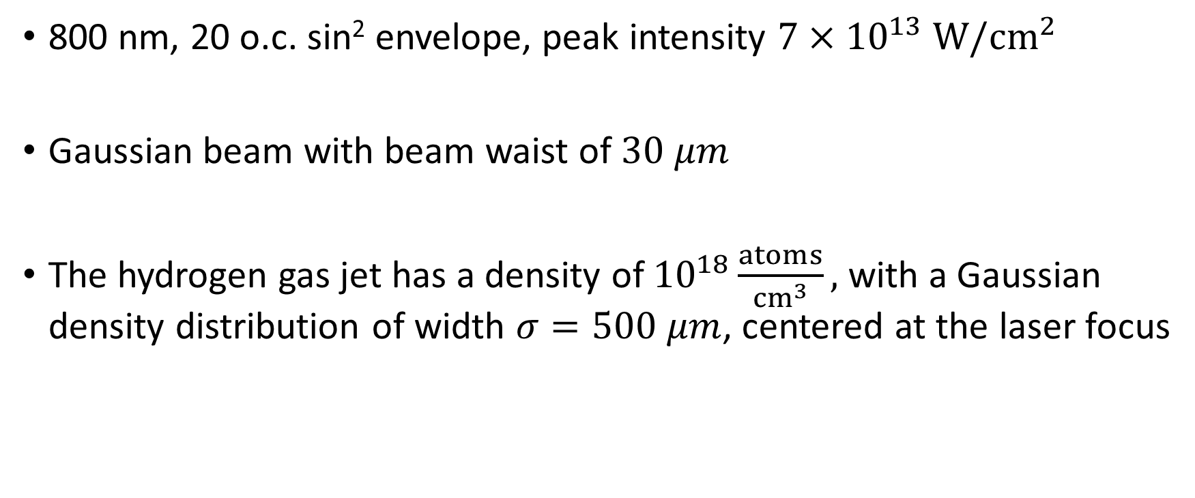
Parameters for macroscopic calculations
800 nm, 20 o.c. sin² envelope, peak intensity $7×{10}^{13} W/cm^{2}$
Gaussian beam with beam waist of $30 μm$
The hydrogen gas jet has a density of ${10}^{18}\frac{atoms}{cm^{3}},$ with a Gaussian density distribution of width $σ=500 μm$, centered at the laser focus

Slide 12
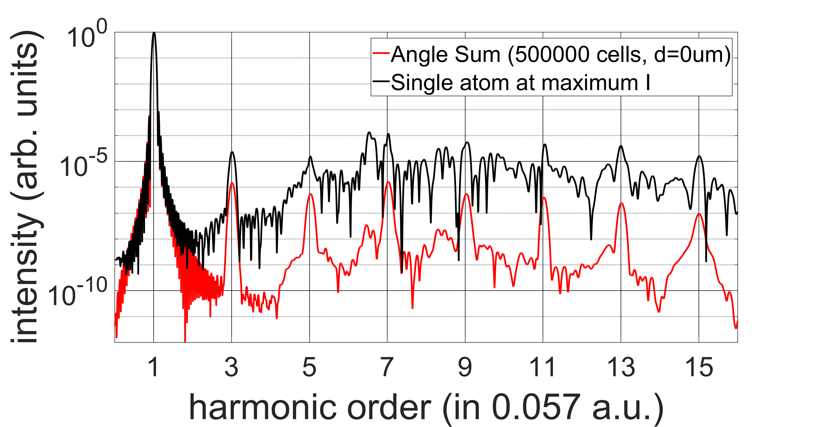
Macroscopic vs Microscopic

Slide 13
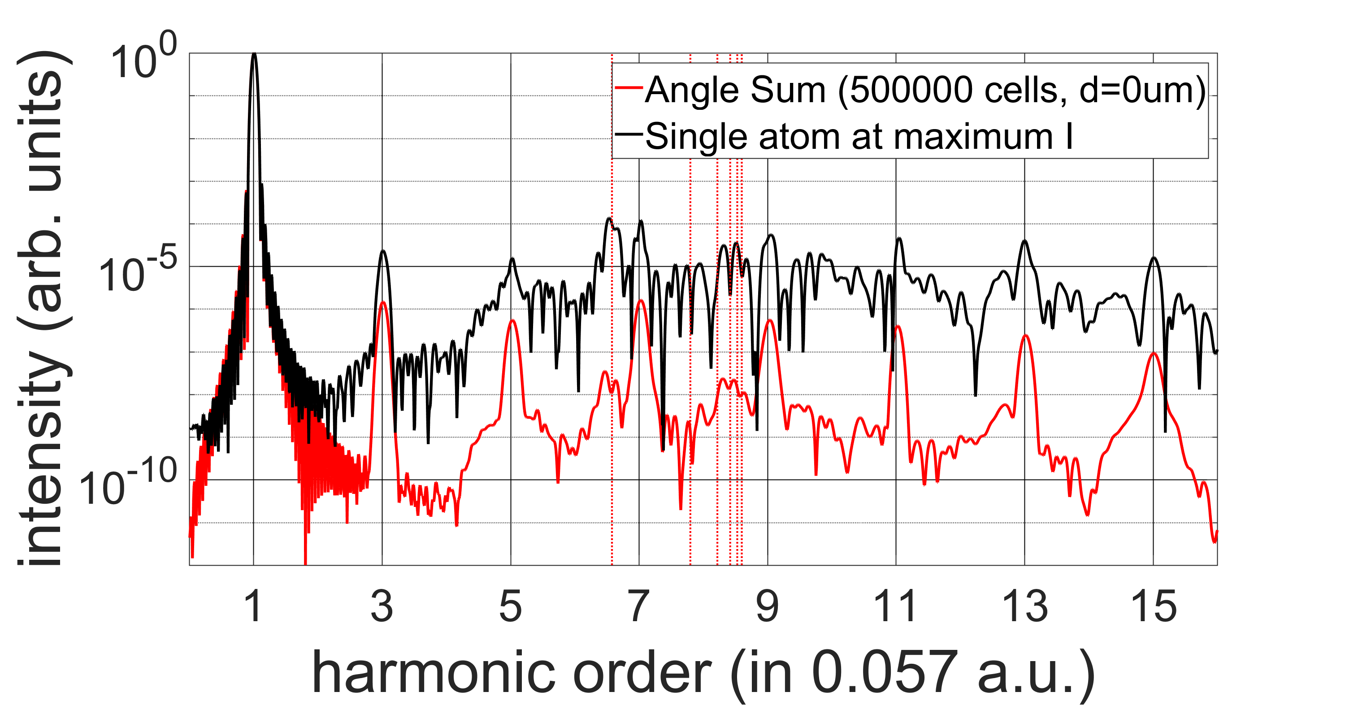
Macroscopic vs Microscopic

Slide 14
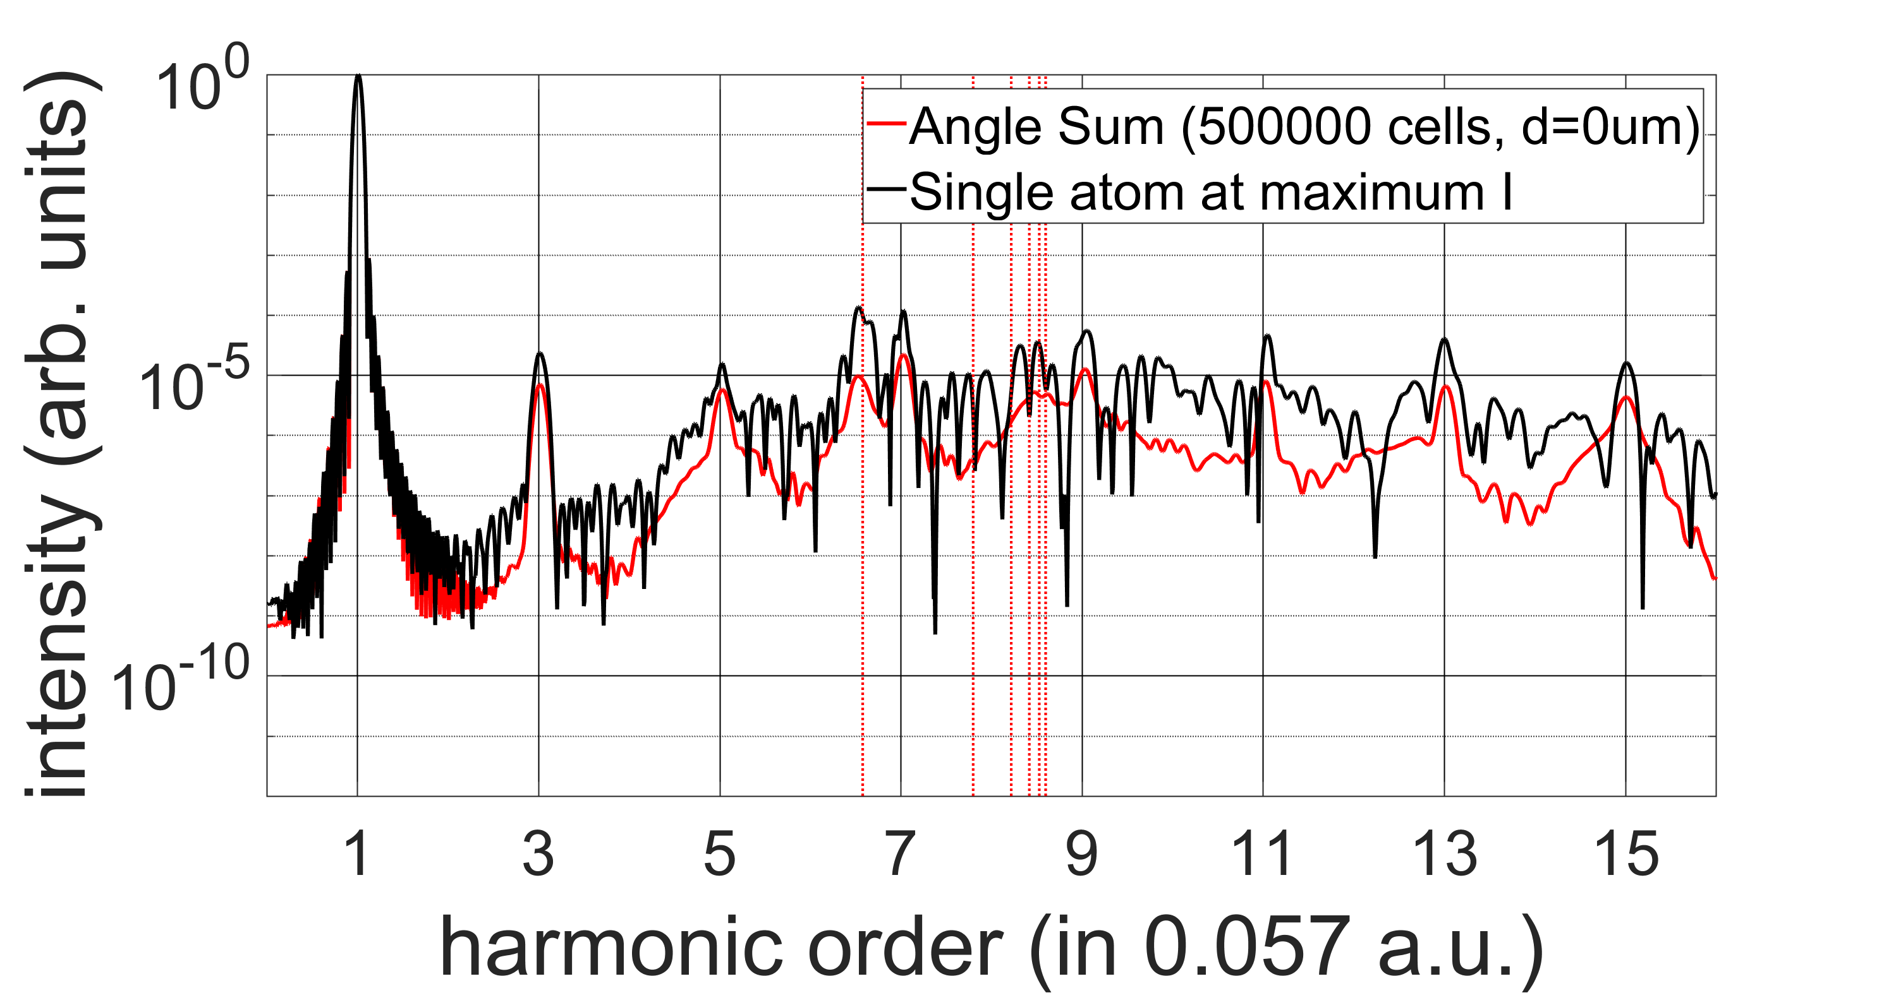
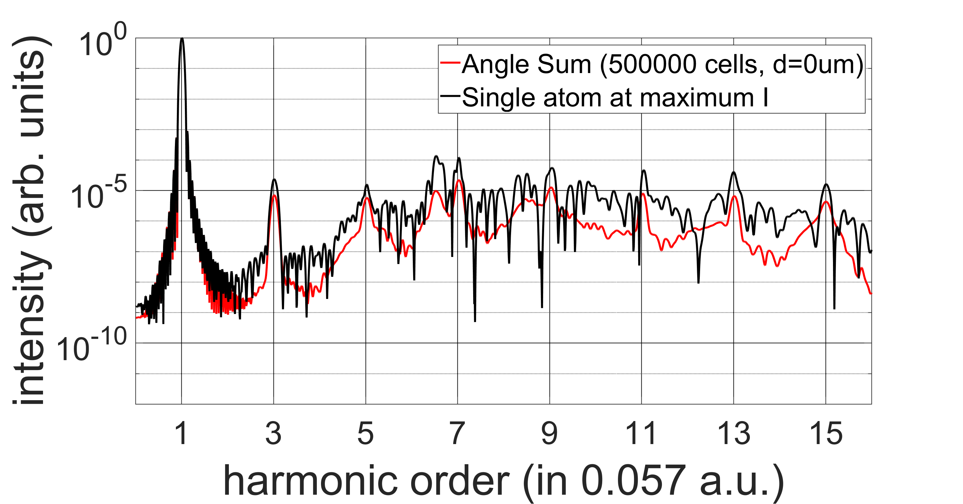
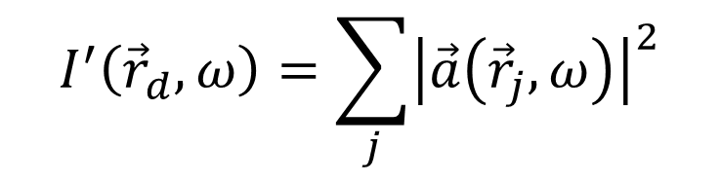
Macroscopic vs Microscopic
$$I^{′}\left({\vec{r}}_{d},ω\right)=\sum_{j}{{\left|\vec{a}\left({\vec{r}}_{j},ω\right)\right|}^{2}}$$

Slide 15
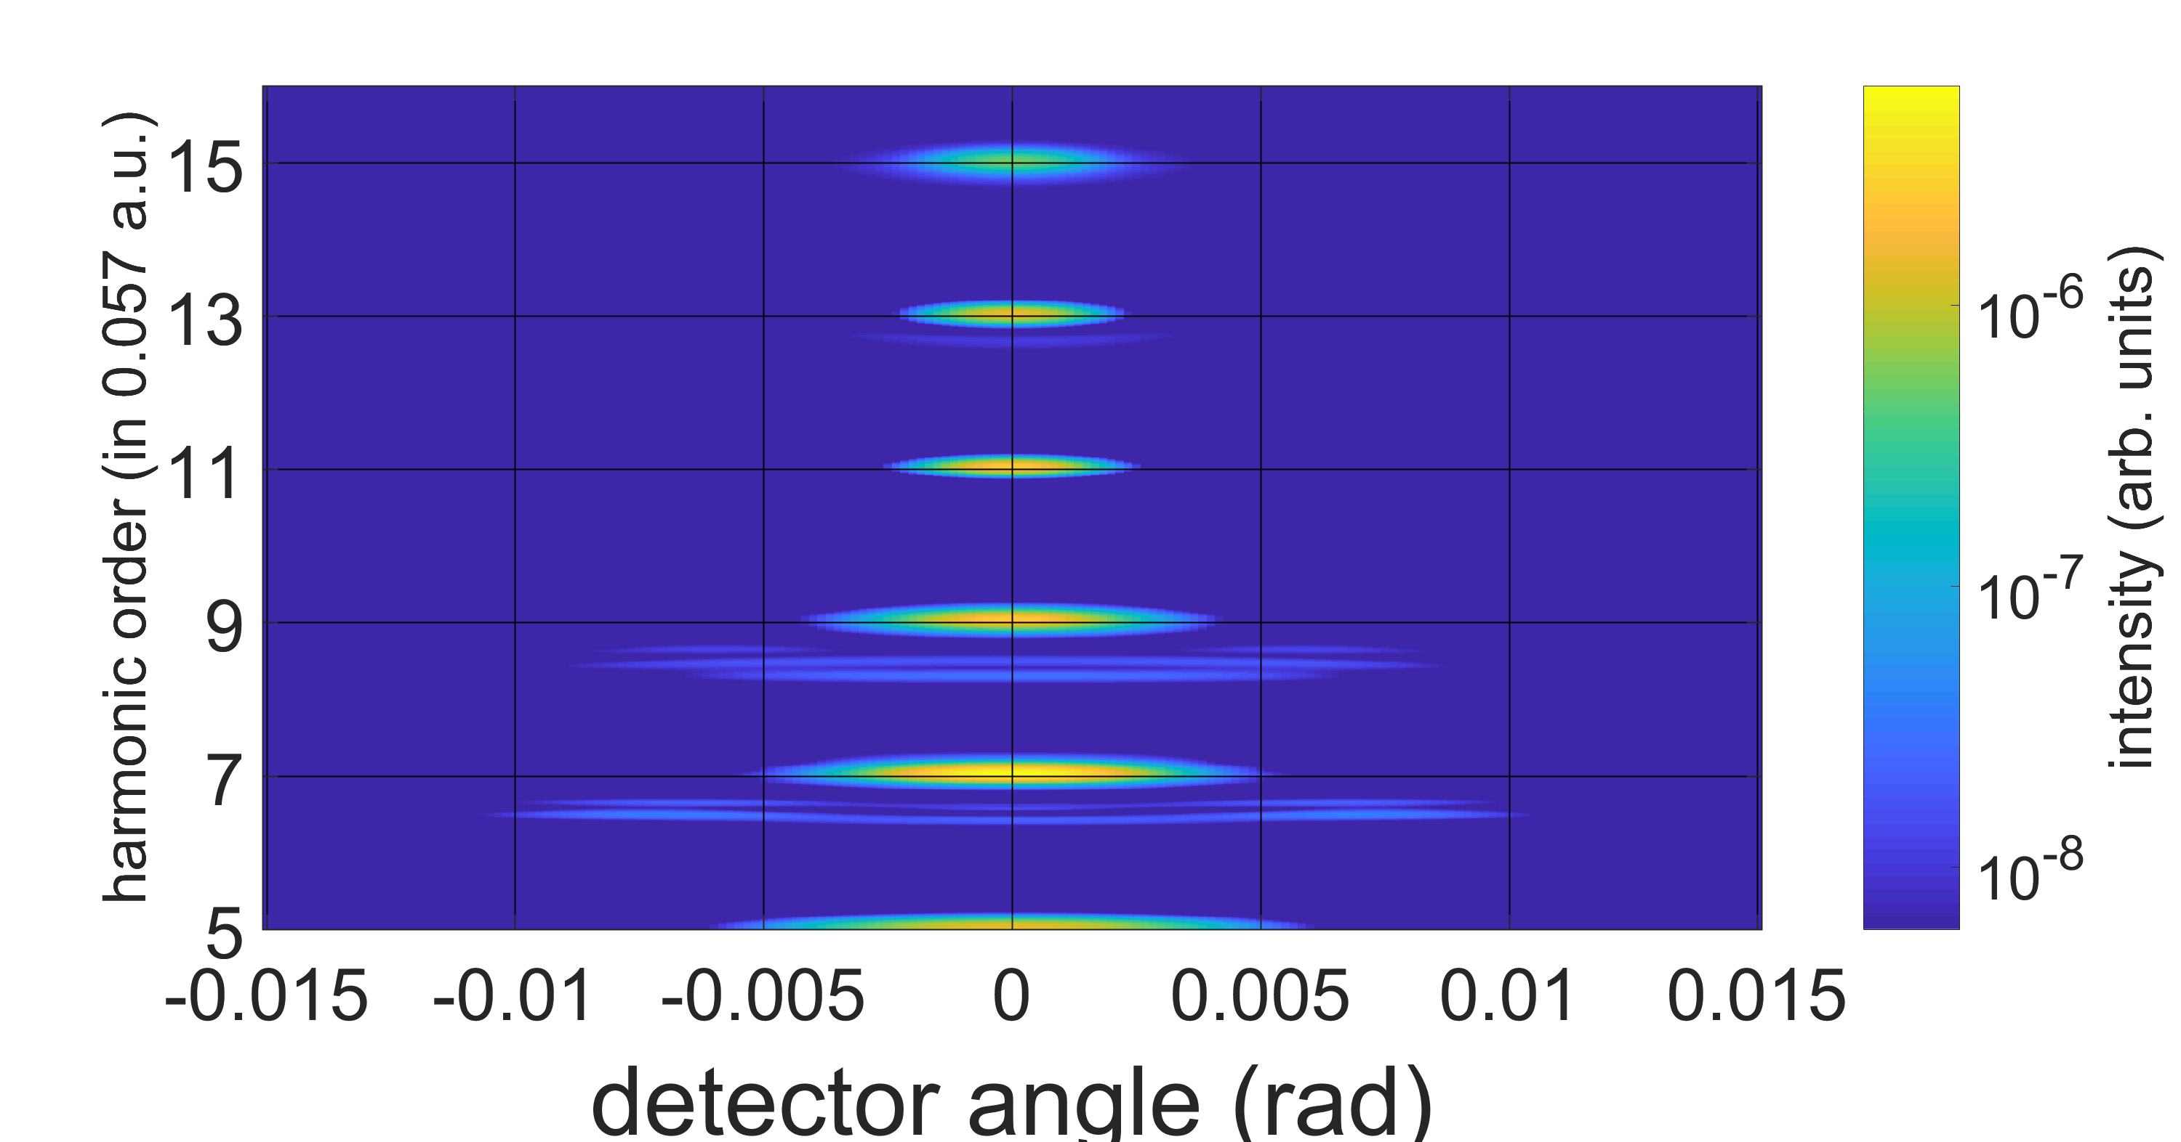
Macroscopic angular dependence

Slide 16
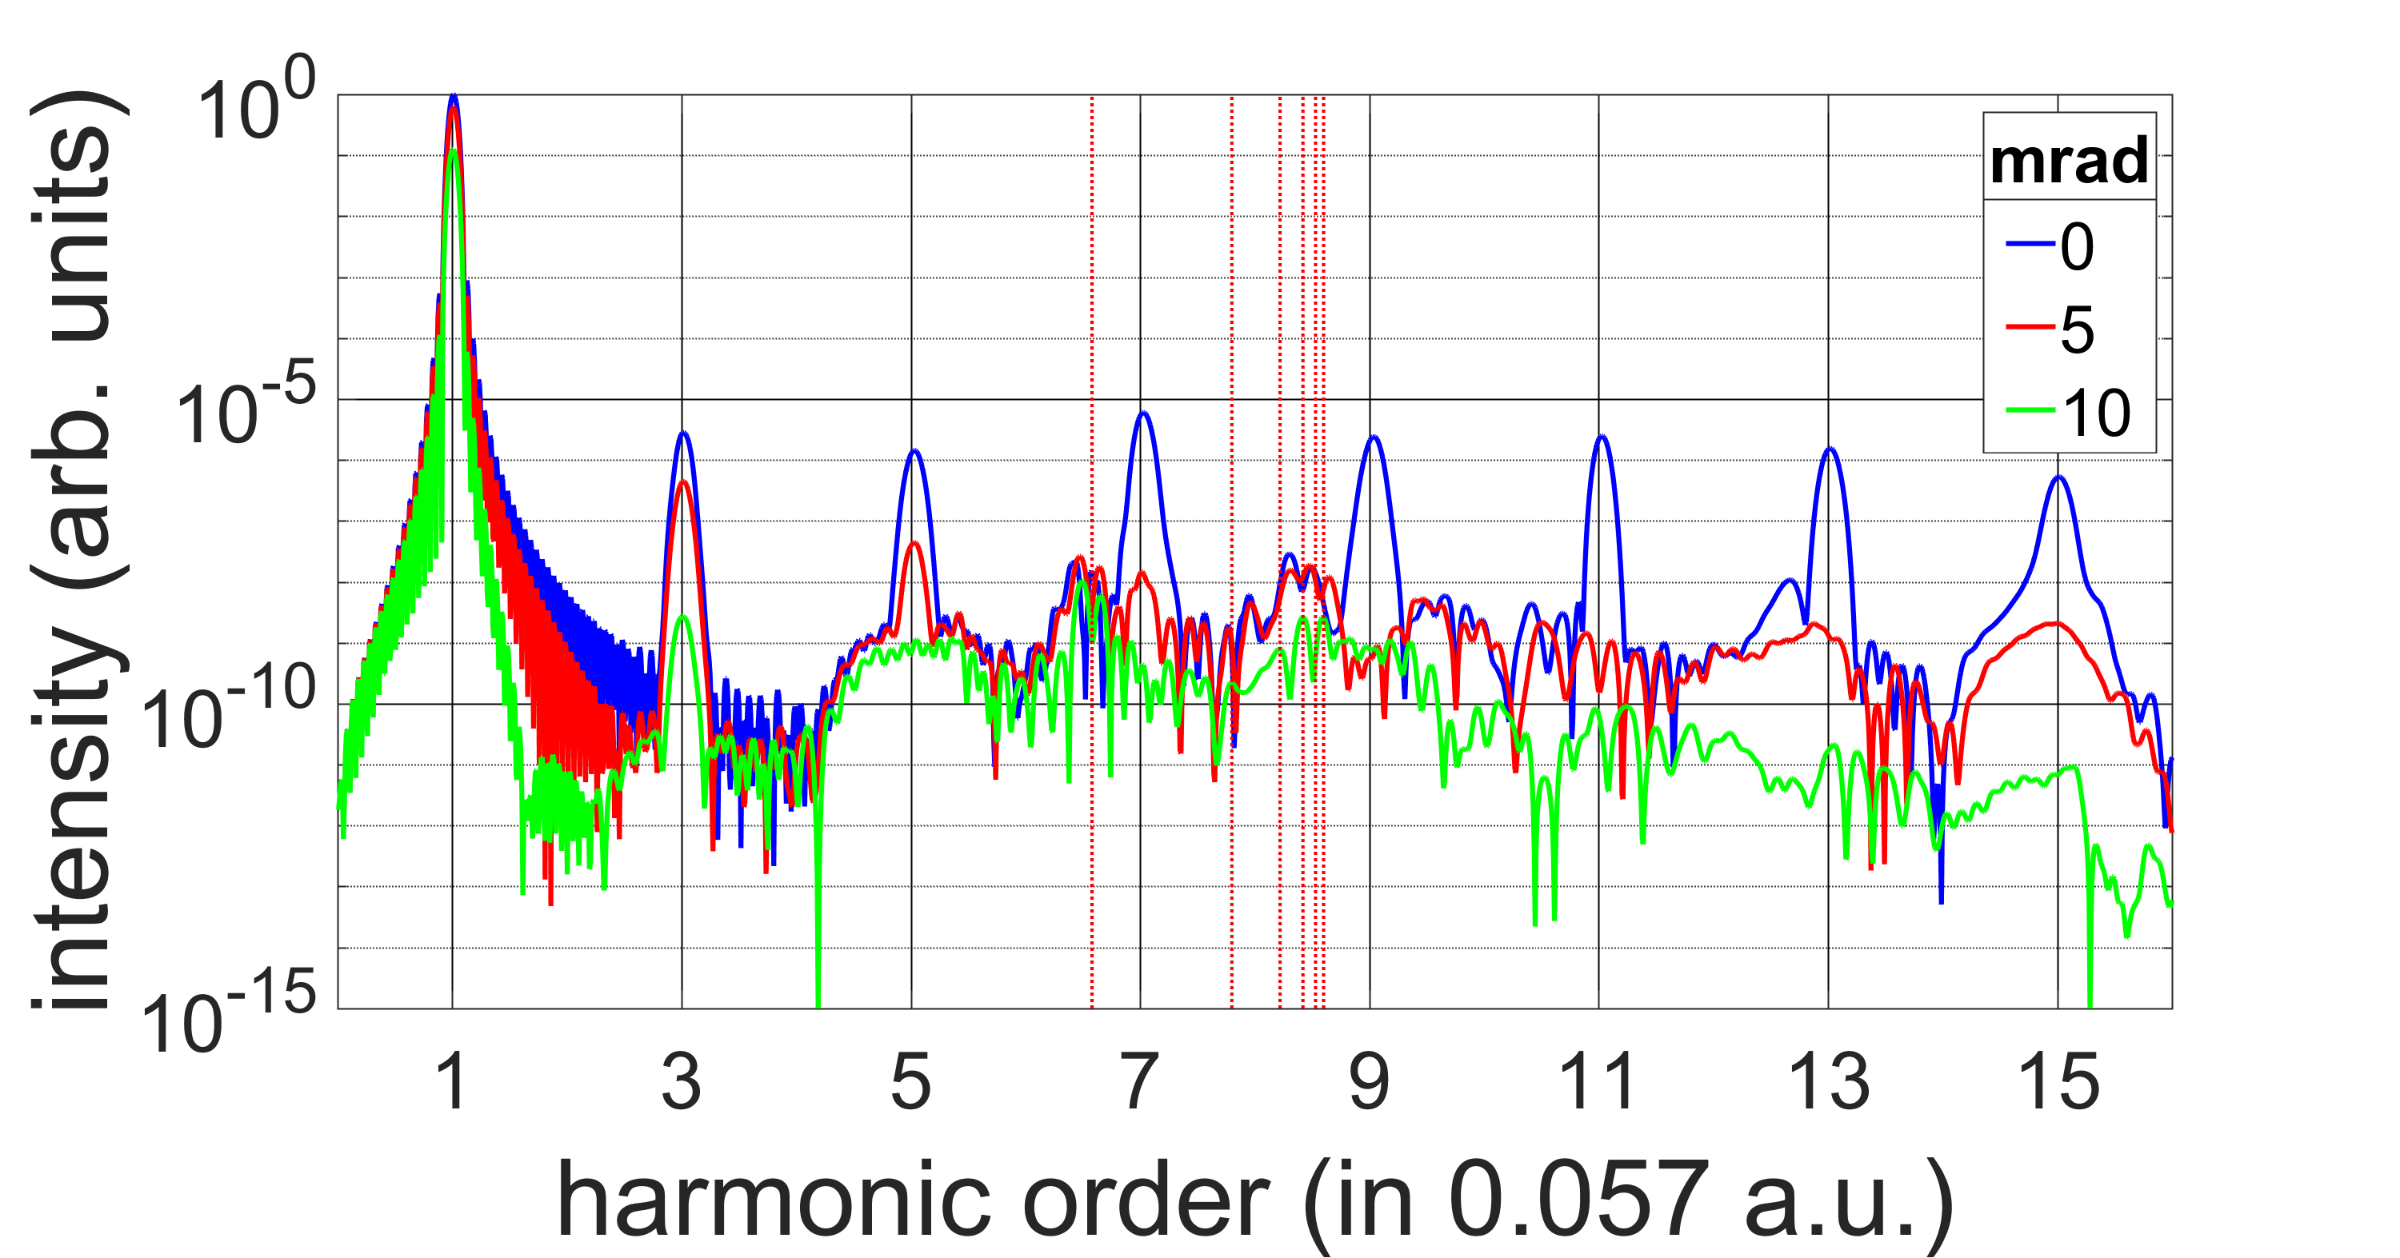
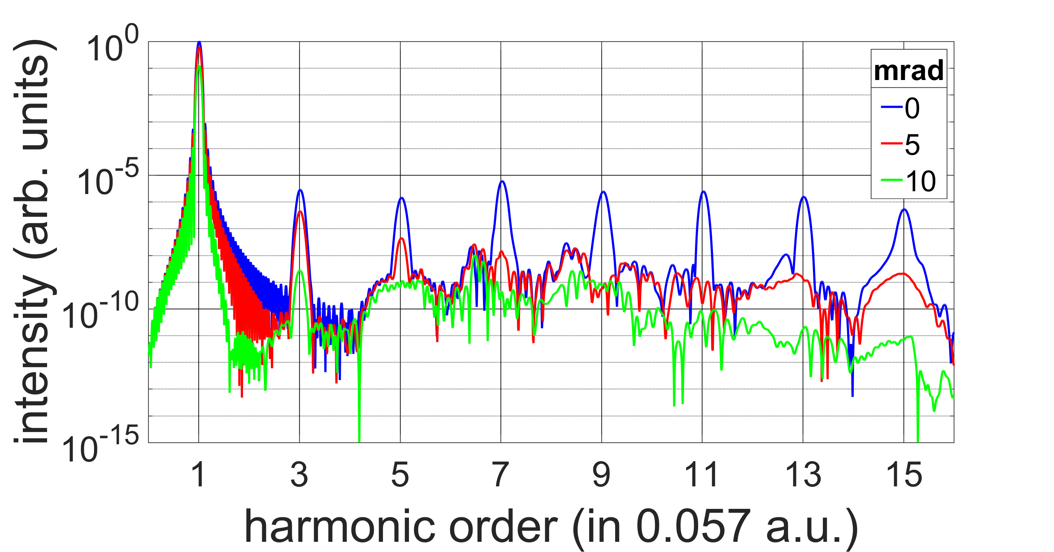
Macroscopic angular dependence

Slide 17
Conclusions
A small set (~100s) of TDSE calculations for set intensities can be accurately interpolated to produce spectra of arbitrary intensities within the range
Certain features in the low-order harmonics survive macroscopic propagation (but with reduced intensity as compared to the harmonics) and display different angular spread than odd-harmonic radiation
We work to extend this work to longer wavelengths, molecular targets (using TDDFT) and driving lasers with other polarizations

Slide 18
Acknowledgements
AFOSR MURI (Grant No. FA9550-16-1-0121).
This work utilized the RMACC Summit supercomputer, which is supported by the National Science Foundation (awards ACI-1532235 and ACI-1532236), the University of Colorado Boulder, and Colorado State University. The Summit supercomputer is a joint effort of the University of Colorado Boulder and Colorado State University.

Slide 19
Limitations
Propagation in ionizing media
Calculation of single atom response

Slide 20
Questions?

Slide 21

Total Radiation (Frequency domain)
$$\vec{E}\left({\vec{r}}_{d},ω\right)=\sum_{j}{\frac{1}{c^{2}\left|{\vec{r}}_{d}\right|}q\vec{a}\left({\vec{r}}_{j},ω\right)\exp\left[−i\frac{ω}{c}\left|{\vec{r}}_{d}−{\vec{r}}_{j}\right|\right]}$$
So, for each atom we need:
Location ${\vec{r}}_{j}$
Dipole acceleration $q{\vec{a}}_{j}$
Laser k-vector ${\hat{k}}_{j}=\hat{k}\left({\vec{r}}_{j}\right)$

Slide 22
The Solution
speed up single-atom calculations
Strong Field Approximation (SFA)
reduce number of single-atom calculations required
Discrete Dipole Approximation (DDA)
Interpolation

Slide 23
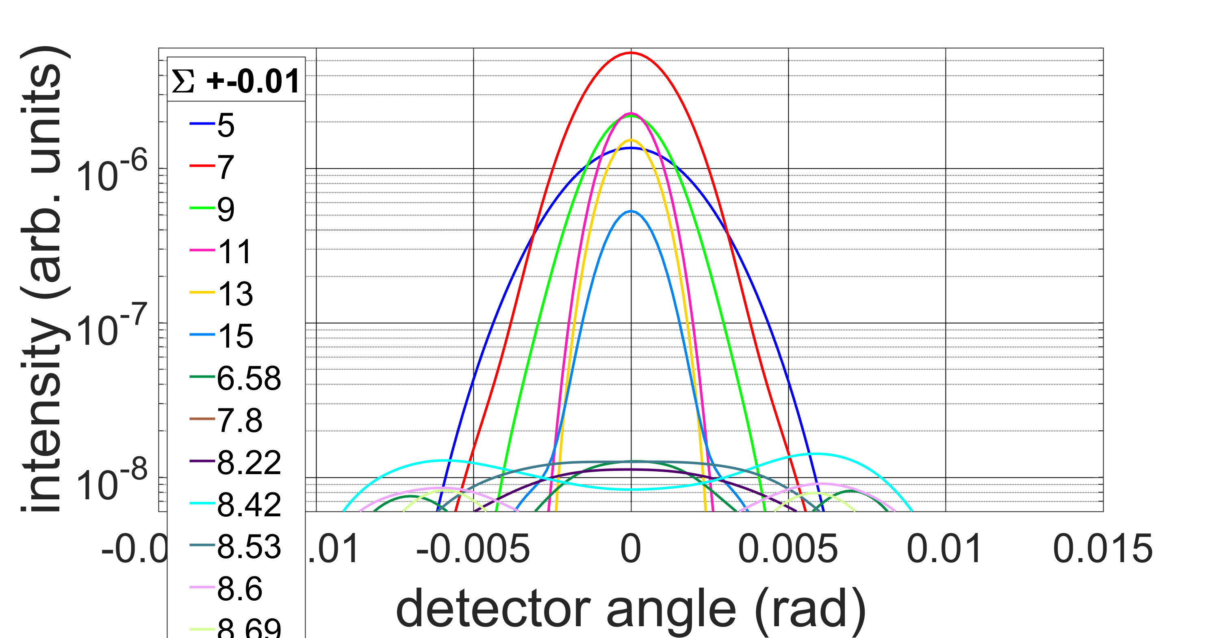

Slide 24
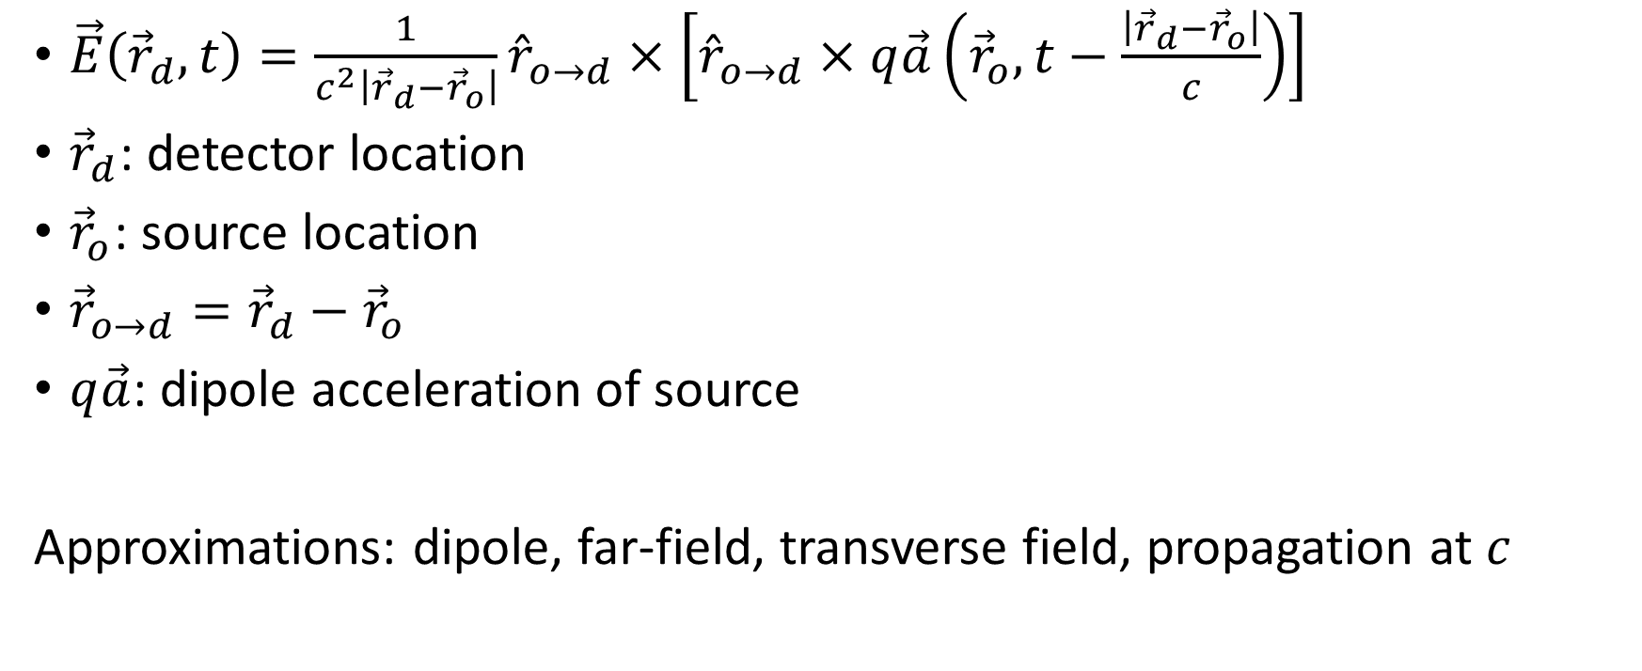
Single Source Radiation
$\vec{E}\left({\vec{r}}_{d},t\right)=\frac{1}{c^{2}\left|{\vec{r}}_{d}−{\vec{r}}_{o}\right|}{\hat{r}}_{o→d}×\left[{\hat{r}}_{o→d}×q\vec{a}\left({\vec{r}}_{o},t−\frac{\left|{\vec{r}}_{d}−{\vec{r}}_{o}\right|}{c}\right)\right]$
${\vec{r}}_{d}$: detector location
${\vec{r}}_{o}$: source location
${\vec{r}}_{o→d}={\vec{r}}_{d}−{\vec{r}}_{o}$
$q\vec{a}$: dipole acceleration of source
Approximations: dipole, far-field, transverse field, propagation at $c$

Slide 25
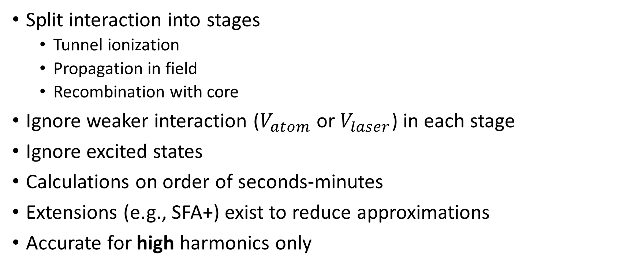
Strong Field Approximation (SFA)
Split interaction into stages
Tunnel ionization
Propagation in field
Recombination with core
Ignore weaker interaction ($V_{atom}$ or $V_{laser}$) in each stage
Ignore excited states
Calculations on order of seconds-minutes
Extensions (e.g., SFA+) exist to reduce approximations
Accurate for high harmonics only

Slide 26
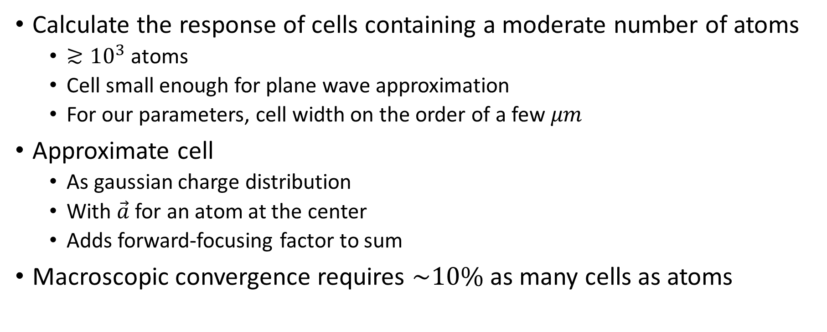
Discrete Dipole Approximation
Calculate the response of cells containing a moderate number of atoms
$≳{10}^{3}$ atoms
Cell small enough for plane wave approximation
For our parameters, cell width on the order of a few $μm$
Approximate cell
As gaussian charge distribution
With $\vec{a}$ for an atom at the center
Adds forward-focusing factor to sum
Macroscopic convergence requires $\sim 10\%$ as many cells as atoms

